Slide 1
INEQUALITIES,
THE IDEA OF JUSTICE and the foundation of corporate governance
Lorenzo Sacconi
University of Milan

Slide 2
Four statements on the relation between justice and corporate governance
(emprical)
There is an essential relation between the growth of unacceptable inequalities and corporate governance models
  Hence if you want to reduce unjust inequalities you have to reform CG

Slide 3
Four statements (2)
2) (explanatory ) The emergence of institutional forms is not driven by unique economic necessity
It is an equilibrium selection process emerging from a multiplicity of possible equilibria.
framed by beliefs systems, social norms and shared mental models,
But the most powerful normative shared mental model thinking the origin of institutions is the social contract model - It may shape the equilibrium selection process
hence the selection of CG institutions is affected by a (contractarian) conception of social justice

Slide 4
Four statements (3)
3) (normative) The socially responsible corporation (or sustainable corporation) is grounded on the idea of the social contract of the firm (micro) ,
from this micro level the justification goes back to higher levels,
  reaching the constitutional contract on CG principles
  ... until CG takes a place in the very general idea of contractarian social justice
socially responsible CG can be justified according to the Rawlsian principles of justice, and this requires much less inequalities than what currently occurs

Slide 5
Four statements (4)
4) (normative) We can go a step forward in tracing back CG to social justice by adopting the capability approach (Sen)
If we make this step, we discover that the essential legal counterparty of the capability concept is a legal liberty (entitlement), not a property right,
Hence CG must be developed to protect the stakeholders multiple liberties and permissions to access the firm assets, by means of a combination of permissions, rights and responsibilities,
and not so much the protection of property rights of a single class of shareholder
Admittedly this is a significant change of perspective

Slide 6
1. MARKETS and growing inequalities
Growing inequality has occurred along the last 40 years , notwithstanding the important re-distribution effectuated through taxation.
  The main difference amongst US/UK and Central and North European countries is the redistributive effect of taxation
  But the underling force pushing toward inequalities are primary inequalities in market income and wealth distribution
  Only if markets income and wealth are not too unequal, taxation may play an effective role in keeping fairness of disposable incomes.

Slide 7
pre- distribution Vs. re- distribution
In front of growing inequalities occurred in the last 40 year in all the developed societies many scholar s(i.e. Atkinson and Milanovic) suggest to focus our attention pre-distribution
In order to counteract market incomes they suggest it is necessary to act on variables such as
  good education for all
  more equitable initial endowments of capital
  worker bargaining power
BUT maybe a variable is missing: the effect of corporate governance institutions on inequalities
  worker participation / stakeholder VS. shareholder value

Slide 8
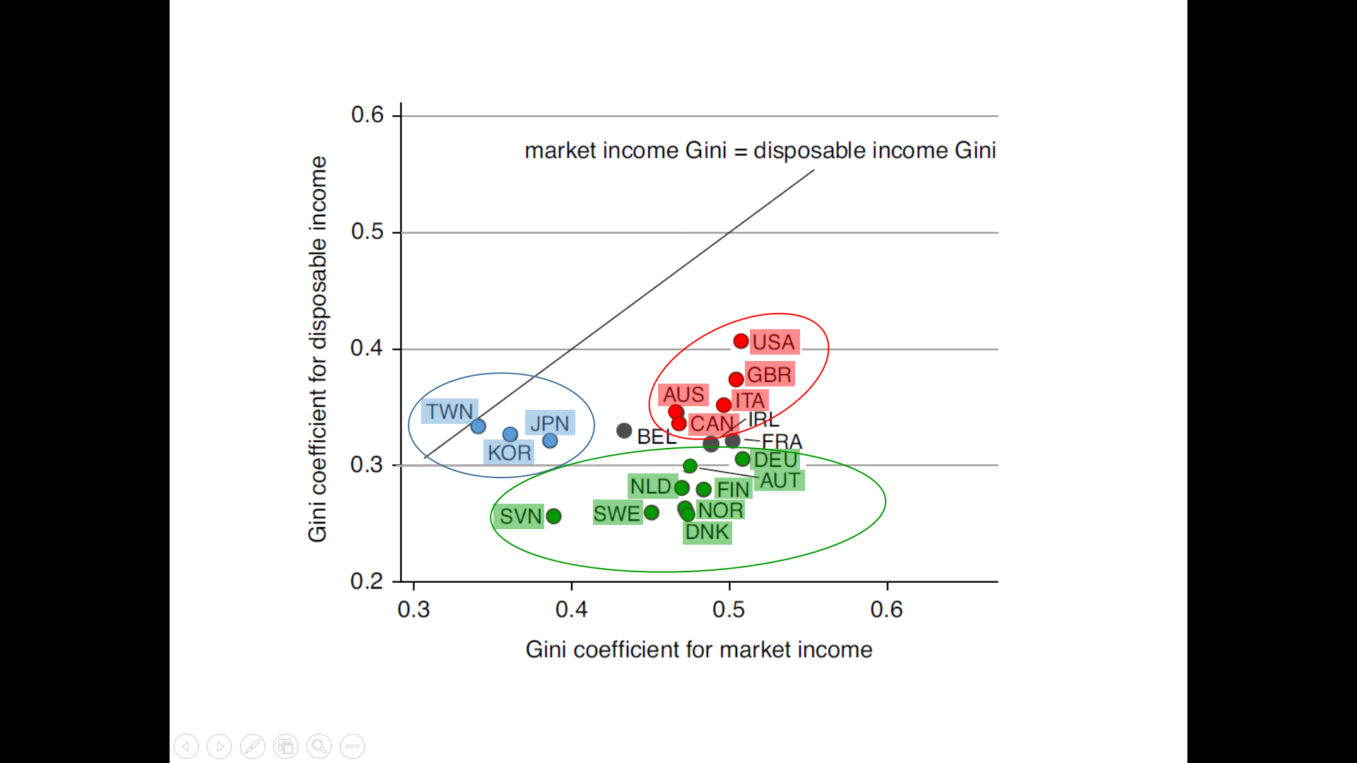
The relation market income ineq./ disposable income ineq.
Along the diagonal blue countries with post taxes ineq. = market ineq.
On the right countries with higher market ineq.
Red countries have high post taxes ineq. Green countries have lower post taxes ineq.
Elaboration from Milanovic, Global inequality, 2016

Slide 9
Three pattern seem to emerge
The “shareholder value” pattern: very large market income inequality, too strong to be mitigated by taxes (after new liberal reforms: US, UK, also Italy?)
Center/North Europe pattern: redistribution counts a lot, but also market income inequality is lower than in the countries adopting the shareholder Anglo-Saxon model.
  countries with a traditions of worker participation like as mittsbestimuung (SVN, SWE, NDL, AUS, NOR, DNK) have all lower market inequality than USA and UK (also Italy)
  DEU is the outlier (why? A failure in German reunification? )
c) Asiatic capitalism: much less market income inequality; market and disposable income inequality (after taxes) are nearly the same.
was there pre-distribution better implemented?

Slide 10
Explaining the Japanese case (aoki)
A variety of corporate gov. models
Historically the “typical” Japanese CG was characterized by mutual co-essentiality of M and W with banks playing the role of a supervisor.
Restructuring occurred in Japan from the ’90, and created a mixed landscape.
  Banks reduced their role
  Under the pressure of the Shareholder Value Myth part of companies adopted the hierarchical Anglo-Saxon model (unilateral control of investors)
But mostly innovative enterprises (Toyota, Sony etc.) invented a hybrid:
  co-essentiality of M and W was kept (life-long contracts) with institutional investors playing a role of monitor,
  but not exercising internal authority (shared by manager with workers)

Slide 11
Explaining the Japanese case: Effects on inequality
Inside mostly productive enterprises income inequality was kept low (comparatively to US):
    this contribute to low market income inequality
But these corporation was not alone in the corporate landscape:
    inequality occurred because of the dualism of governance models and labor market contracts
Quite paradoxically
  the most productive (high tech) were less unequal within themselves
  but inequalities emerged with respect to the less productive and more hierarchical part of the corporate landscape.

Slide 12
Summing up to this point
The model of capitalism and CG affects the level of inequalities
If you want to reduce inequalities the basic pre-distributive mechanism to be considered is the CG model
But the question is :
  can CG institutions be affected by social justice norms and principles accepted as social norms ?
  Or are they driven by a necessary logic of efficiency?
Even if old fashioned law & economics would say that only efficiency may affect CG , on the contrary the reply is yes:
according to contemporary game theoretical explanation, Social norms, Beliefs systems and Normative shared metal models count a lot in shaping the equilibrium selection process

Slide 13
2. How more egalitarian CG institutions could emerge ?
CG institutions must be seen as endogenous since in principle they should be accepted by participants , so that the notion of equilibrium is essential
Institutions are behavioral equilibrium regularities
  supported by beliefs systems and summary cognitive representation,
  by responding to which, agents induce a persisting regularity of behavior (best responses reproduce the same regularity) : Nash equilibrium
  Equilibrium regularities are achieved through an equilibrium selection dynamics modeled as adaptive learning and trial and error process

Slide 14
Emergence of institutions
But the explanation of equilibrium selection and institution emergence is not confined to the evolutionary dynamic
On the contrary, selective dynamics reflect initial conditions or starting points
  positioning the equilibrium dynamics in the basin of attraction of one or another equilibrium institution
  starting point are induced by higher order cognitions: shared mental models /accepted view or values

Slide 15
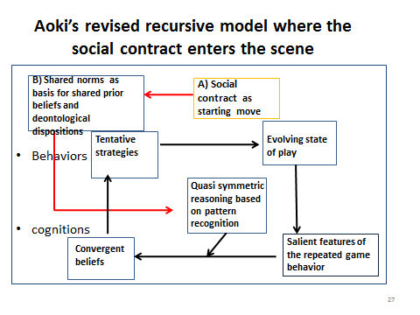
See Aoki, 2001 and 2010, and Sacconi (palgrave) 2011a , (EE) 2013

Slide 16
Inner circle and inputs coming from outside
The inner circle describes the equilibrium dynamics converging to an institution
  starting from a quasi-symmetric pattern recognition of the game, induces tentative beliefs and choices resulting in new summary representations and beliefs
  At the end choices become mutually compatible as best responses to their summary representation
But the inputs coming from outside suggests that
  shared mental models shape empirical and normative beliefs according to which any game is recognized and seen
  shared models are the first step of the equilibrium dynamics in concrete games
  And so they put the dynamics on a given equilibrium selection path

Slide 17
shared mental models
Shared norms (or principles) enter the players’ mental model of how the game should be played,
They
  shape the players’ reciprocal disposition to act and their beliefs,
  give reasons for acceptance of a mode of behavior before it have been established as an equilibrium point.
The question is: what collective mode of reasoning may explain that norms or principles are accepted, before than the evolutionary pressure may have operated in that direction?

Slide 18
Social contracts
The best justificatory account of how norms are ex ante accepted is the social contract
  Contractarian norms result from voluntary agreement in an original position, coming before than any detail of the equilibrium dynamic has been experienced
  Here typically normativity meets explanation: a normative mental models (the idea if fair agreement = the social contract) affects equilibrium selection
  Ref. Sacconi (GE) 1993, Sacconi & Moretti (IJUFKS) 2007, Sacconi (EE) 2013

Slide 19
let focus ON The Emergence of the socially responsible (or sustainable) corp. and its multi-stakeholder cg model
“Who runs the firm (entrepreneurs, boards of directors and managers) owes extended fiduciary duties to strict sense stakeholders (doing specific investments) and broad sense stakeholders (bearing important externalities) beyond owners”
  to avoid negative externalities
  To allow fair participation in the value created
Correlatively stakeholders must have the right to participate in CG in order to supervise that fiduciary duties are complied with
Ref: Sacconi 2004/7, (JBE) 2006a, (palgrave) 2011a

Slide 20
continues
It is definitely transaction cost efficient:
  avoiding abuse of authority incentivizes all the stakeholders’ specific investments
But, it is not the “only spontaneous equilibrium”
  Entrepreneurs maybe are myopic: a larger slice today is better than a smaller slice of a larger pie tomorrow
  reputation effects are very fragile, and may repay them very slowly in a world of incomplete contract (unforeseen contingencies)
  a reputation of “partial abuser” may be profitable (playing the role of a Stackelberg leader).
Nonetheless we may argue that social norms based on the shared mental model of a social contract direct the equilibrium selection process toward the socially responsible CG model

Slide 21
4. How does the Multi-stakeholder GC model derives FROM the social contract?
4 steps in the social contract justification of the multi-stakeholder CG from micro to macro
  1. The micro-level social contract of the firm
  2. the foundation of the micro SC in the constitutional and post-constitutional contracts of the firm
  3. the explanation of the constitutional contract on CG as an equilibrium selected in a non cooperative “original position” game, under the veil of ignorance (Binmore)
  4. The achievement of the theory of justice level

Slide 22
How the Multi-stakeholder CG model derives FROM the social contract?
  This process ascends
  from the isolate model of a firm SC at micro level,
  to the foundation of corporate law in a more general constitutional contract,
  To the selection of a CG constitution in a state of nature as an equilibrium selection process which entails equality
  and hence reaches the level of the theory of justice

Slide 23
1st: The micro-social contract of the firm
Seen in isolation, the firm is constituted by its stakeholders mutual agreement: a multi-stakeholder association exiting the state of nature (incomplete contracts) by means of ….
  pactum unionis: fair distribution of the maximum surplus obtained by cooperation from a fair status quo
  pactum subjectionis: allocation of authority minimizing opportunism, under the proviso of respecting the extended fiduciary duties owed to non-controlling parties.
Even if stakeholder have conflicting interest , the SC solves the balancing problem by a unique objective function :
  the Nash bargaining solution in a cooperative context
Ref: Sacconi 2004/7 Sacconi (JBE )2006a, Sacconi (Palgrave ) 2011a

Slide 24
2nd: Constitutional and post-constitutional contracts in GC
But how is it possible that the bargaining status quo of the micro social contract does not reflect unfair inequalities?
  We ascend a level
At the constitutional stage a bargaining game “behind the veil of ignorance” selects the fair allocation of resources, rights, responsibility,
It settles the “status quo” and the strategy sets available to the players in the post constitutional agreement on the firm
At the post-constitutional stage different cooperative coalition/firm may be formed, and any agent claims a payoff corresponding to her contribution (Shapley value).
Ref. Sacconi (Springer) 2000, Sacconi JBE 2006a

Slide 25
Constitutional and post-constitutional contracts in GC
It follows that :
  the constitutional agreement is egalitarian (NBS) since under the veil the payoff space is symmetric and nobody may support any differential claims on basic endowments
  the solution of post-constitutional bargaining reflects responsible effort carried out through symmetric endowments
  If rationality, endowments and the capability for effort are similar enough contributions will be also similar,
  so the final distribution cannot be too unequal

Slide 26
3rd: selection of an equilibrium constitution From the “state of nature ”
In order to be consistent with the very idea of the social contract - an agreement in “the state of nature” - the firm constitutional contract must display a self-sustaining property – Nash equilibrium.
restrict the available/feasible set of corporate constitutions to institutions that could emerge as repeated game equilibria (typically multiple).
The SC contract method consists in using the “veil of ignorance” as an equilibrium selection device (see Binmore 2005)

Slide 27
3rd: . selection of an equilibrium constitution From the “state of nature”
The veil of ignorance symmetrizes the feasible outcome space:
  the symmetric intersection of the original equilibrium space and its symmetric translation with respect to the players positions
Within this space the only reasonable bargaining solution is egalitarian, and corresponds to Rawls’ maximin
CG constitutions are then compared according to the mutual acceptability of their egalitarian solutions
  Pareto efficiency decides only amongst egalitarian solutions
Ref: Sacconi (Palgrave) 2011b

Slide 28
4th CG takes a place in the theory of justice
The liberal tradition (Rawls) of distributive justice has excluded corporations from the domain of distributive justice
  being this limited to fundamental public law institutions whereas the corporation was seen as a “free association”
But there was no reason to do that
  corporation distribute primary social goods like as power and authority, career opportunities, income and wealth, and the basis for self-respect (decent work etc.)
  they are not free association with zero exit costs: lock-in effect due to specific investments and authority allocation entailing the threat of heavy costs
Corporations are hence part of the “basic structure”
Ref: Fia and Sacconi (JBE) 2018

Slide 29
CG rules, a matter of justice
The key point is simply not seeing CG as a “private law” subject left aside in a-moralized zone independent of social justice
but as matter of social justice entering the scope of the social contract
BUT this is exactly the point where the liberal tradition of thought on social justice failed
On the plan of the history of ideas
  increasing inequalities can be traced back to the renounce of using the idea of justice in order “frame” the CG domain

Slide 30
4. Going beyond traditional views: Sen's capability approach and CG
Why the CA ? Need for
  a more concrete and extensively applicable idea of justice
  Also applicable to institutions that typically does not belong to the political realm
  Taking account that the same amount of “primary goods” may entail completely different states of well-being under different (natural and legal) environments, individual characteristics, or social norms
  What counts is the substantial equality in the capabilities to function, under these different circumstances, in order to achieve well-being
Ref: Fia and Sacconi (JBE) 2018

Slide 31
Basics: Functionings and capabilities
Functionings (in place of social primary goods) as eudemonic concept of wellbeing:
  human flourishing in different areas “being” and “doing” valued by the person
Capabilities
  transformation functions from goods characteristics to achieved functionings
  but also the choice set wherein the individual freely chooses what functioning she wants to achieve
Hence capabilities are effective liberties and substantial opportunities (with both instrumental and intrinsic value)

Slide 32
Analyzing Capabilities (skills and entitlements)
In order to have actual liberties one needs the ability to transform given characteristics into a chosen functioning, BUT ALSO the entitlement to do so
  In fact, one may have the ability to do something while not having access to some good necessary for exercising the activity,
Therefore capabilities are
  a) skills to function,
  b) but also the legal entitlement to choose to function in some way, which entails the freedom to access resource or the right of not being excluded from accessing such resources

Slide 33
Analyzing entitlements by means of fundamental legal notions
(Wesley newcomb Hohfeld. Foundamental legal conceptions 1917 )
A pair of opposed legal concepts: ‘liberties VS. claim-rights’ (concerning the relation with goods)
They can be explained by reference to the basic deontic logic notions duty VS. permission, and the aletic modal logic notions necessity VS. possibility
A) A right is an agent X’s claim that somebody else (Y) accomplishes (or refrains from accomplishing ) an action A on a good
  it is correlated to another person Y’s duty (the normative necessity) to accomplish (or to abstain from accomplishing ) an act A toward X

Slide 34
Analyzing entitlements by means of fundamental legal notions
B) A liberty is the opposite than a right:
agent Y as a liberty concerning A if he has no duties toward X to do the act A or to abstain from A
  It is correlated to the same agent‘s permission (the normative possibility) of not doing or not abstaining from doing A,
  and it is the opposite (the limitation) of the same agent duty; it signifies the absence of Y’s duty to do or to refrain from doing A toward X.

Slide 35
Hohfeldian liberties VS property rights
A property right is a claim erga omnes, i.e. against anyone.
To say that "X has the property right over the shop (B)" is equivalent to say that "X has the claim that anyone Y refrains from accessing (A) the shop (B), if not admitted",
  Or, “X has the claim that Y is excluded from the shop, if not admitted”.
The negation of Y’s duty (NO-duty) is a liberty (or a permission): “ Y is free of (not) not-entering the shop (double negation) i.e “Y is free to enter the shop. Even if not admitted “

Slide 36
Hohfeldian liberty VS property rights
It’s now evident that the legal liberty - in hohfeldian sense - is a limitation of property rights and is the permission to the agent Y of accessing the good, constraining the property right on X.
This permission, however, does not turn Y into the owner,
it is just a limit placed over X’s property right, where the limit is the non-excludability of Y from B.

Slide 37
The basic idea of the connection between the capability approach and the analysis of jural relations
A world full of capabilities is a world in which there would be a plenty of jural liberties ( i.e. both unilateral and bilateral liberties.) : etitlements
Liberties of functioning in different ways, insomuch as they are based on the preemption of inaccessibility claims and exclusion-duties,
On the contrary these would be normatively affirmed in a world in which everything were privately owned .
Hence the more property rights the less capabilities and wellbeing

Slide 38
Legal Notions applied to capabilities
Claim-rights can be
  ‘negative’ : a right of non-interference that limits someone else freedom.
  ‘positive’: requiring Y to provide some service to X.
Capabilities as legal entitlements are first of all legal liberties : The Privilege to access goods, information, knowledge or a decision process necessary to achieve a functioning
but they can be protected also by claim right
  Positive claim-rights to receive the education necessary to the formation of some skill (capability as ability)
  Negative claim-rights NOT to be excluded from the asset necessary for functioning

Slide 39
Workers’ entitlements in the CG domain
From the analysis of capabilities according to fundamental legal notions, worker entitlements in the CG domain are:
  Freedom to access corporate asset (necessary to exercise the ability to function as a worker or a professional)
  Freedom to access the corporate decision process (capability as having a real choice to function)
  A claim rights (positive) to receive all the relevant information to participate effectively in the decision process (formation of the capability-skill)
  A claim right (negative) not to be excluded from the firm (double negation protecting access from obstruction)
    no arbitrary dismissal

Slide 40
What about ownership of the firm?
The CA does not reallocate ownership to the employees (or other stakeholders) .
however it certainly impose limitations on the scope of the “ownership of the firm”.
It doesn’t amount anymore to a full property right: there is not the full power to exclude the worker,
  ownership of the firm doesn’t correspond anymore to the ownership as the right of “utendi et abutendi”, a “right in rem” that tells to anybody (“erga omnes”) - to keep out of an object of property .
This cannot be so, since the owner cannot exclude the worker from accessing the company assets which are necessary to her functionings

Slide 41
democratic equality
Are all the inequalities of capabilities in the domain of work to be equalized or redressed? NO
  This would entail a complete ranking of all the capabilities and to assess trade-offs between them
what is needed is a suffcientarian criterion for “equality of capabilities” :
  Capabilities are sufficiently equal if a threshold is reached that guarantees democratic equality of citizens also in the workplace (Elizabeth Anderson)
  avoiding domination and abuse of authority in the corporate domain
my list of entitlements provisory identifies sufficient capabilities for democratic equality in the corporate domain

